Slide 1
Linux device driver
Day 30 PPT
-SUBITHRA s

Slide 2
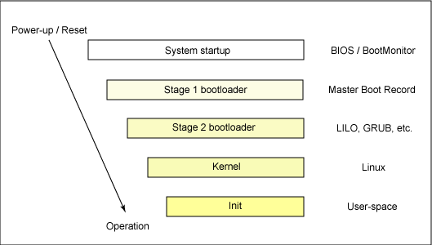
How Linux boot?

Slide 3
How computer startup?
Booting is a bootstrapping process that starts operating systems when the user turns on a computer system
A boot sequence is the set of operations the computer performs when it is switched on that load an operating system

Slide 4
Booting sequence
Tern on
CPU jump to address of BIOS (0xffff0)
BIOS runs POST (power-on self test)
Find bootale devices
Loads and execute boot sector form MBR
Load OS

Slide 5
MBR (Master Boot Record)
OS is booted from a hard disk, where the master boot record (MBR) contains the primary boot loader
The MBR is a 512-byte sector, located in the first sector on the disk (sector 1 of cylinder 0, head 0)
After the MBR is loaded into RAM, the BIOS yields control to it.

Slide 6
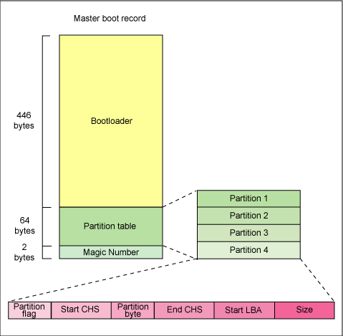
MBR (Master Boot Record)

Slide 7
MBR (Master Boot Record)
The first 446 bytes are the primary boot loader, which contains both executable code and error message text
The next sixty-four bytes are the partition table, which contains a record for each of four partitions
The MBR ends with two bytes that are defined as the magic number (0xaa55). The magic number serves as a validation check of the MBR

Slide 8
Extracting the MBR
To see the contents of MBR, use this command:
# Dd if=/dev/hda of=mbr.Bin bs=512 count=1
# Od -xa mbr.Bin
**The dd command, which needs to be run from root, reads the first 512 bytes from /dev/hda (the first integrated drive electronics, or IDE drive) and writes them to the mbr.Bin file.
**The od command prints the binary file in hex and ascii formats.

Slide 9
Boot loader
Boot loader could be more aptly called the kernel loader. The task at this stage is to load the linux kernel
Optional, initial RAM disk
GRUB and LILO are the most popular linux boot loader.

Slide 10
Other boot loader (Several OS)
Bootman
GRUB
LILO
NTLDR
XOSL
Bootx
Loadlin
Gujin
Boot camp
Syslinux
GAG

Slide 11
GRUB: GRand Unified Bootloader
GRUB is an operating system independant boot loader
A multiboot software packet from GNU
Flexible command line interface
File system access
Support multiple executable format
Support diskless system
Download OS from network
Etc.

Slide 12
GRUB boot process
The BIOS finds a bootable device (hard disk) and transfers control to the master boot record
The MBR contains GRUB stage 1. Given the small size of the MBR, stage 1 just load the next stage of GRUB
GRUB stage 1.5 is located in the first 30 kilobytes of hard disk immediately following the MBR. Stage 1.5 loads stage 2.
Grub stage 2 receives control, and displays to the user the grub boot menu (where the user can manually specify the boot parameters).
Grub loads the user-selected (or default) kernel into memory and passes control on to the kernel.

Slide 13
Kernel image
The kernel is the central part in most computer operating systems because of its task, which is the management of the system's resources and the communication between hardware and software components
Kernel is always store on memory until computer is tern off
Kernel image is not an executable kernel, but a compress kernel image
Zimage size less than 512 KB
Bzimage size greater than 512 KB

Slide 14
Task of kernel
Process management
Memory management
Device management
System call

Slide 15
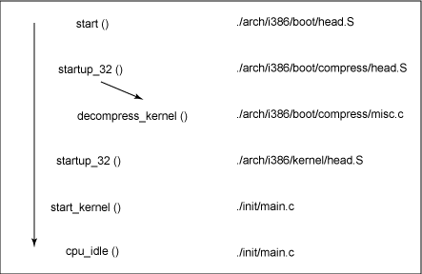
Major functions flow for Linux kernel boot

Slide 16
System processes
Process ID | Description
0 | The Scheduler
1 | The init process
2 | kflushd
3 | kupdate
4 | kpiod
5 | kswapd
6 | mdrecoveryd

Slide 17
Inittab file
The inittab file describes which processes are started at bootup and during normal operation
/etc/init.D/boot
/etc/init.D/rc
The computer will be booted to the runlevel as defined by the initdefault directive in the /etc/inittab file
Id:5:initdefault:

Slide 18
Runlevels
Runlevel | Scripts Directory (Red Hat/Fedora Core) | State
0 | /etc/rc.d/rc0.d/ | shutdown/halt system
1 | /etc/rc.d/rc1.d/ | Single user mode
2 | /etc/rc.d/rc2.d/ | Multiuser with no network services exported
3 | /etc/rc.d/rc3.d/ | Default text/console only start. Full multiuser
4 | /etc/rc.d/rc4.d/ | Reserved for local use. Also X-windows (Slackware/BSD)
5 | /etc/rc.d/rc5.d/ | XDM X-windows GUI mode (Redhat/System V)
6 | /etc/rc.d/rc6.d/ | Reboot
s or S |  | Single user/Maintenance mode (Slackware)
M |  | Multiuser mode (Slackware)

Slide 19
rc#.d files
rc#.d files are the scripts for a given run level that run during boot and shutdown
the scripts are found in the directory /etc/rc.d/rc#.d/ where the symbol # represents the run level

Slide 20
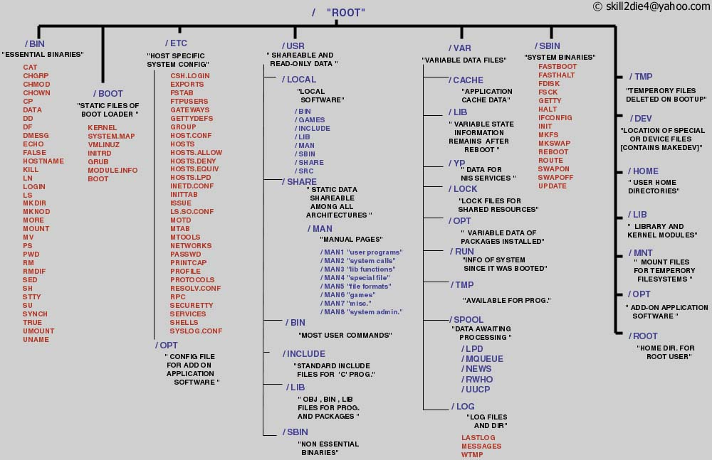
Linux files structure

Slide 21
THANK YOU

